Slide 1
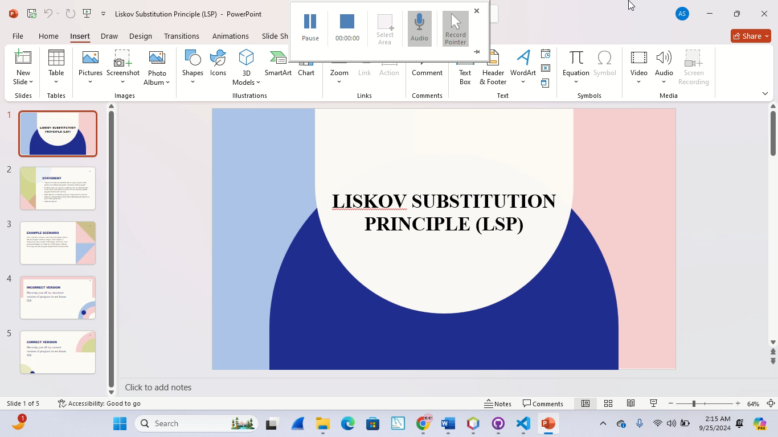
Liskov Substitution Principle (LSP)

Slide 2
Statement
"Objects of a subclass should be able to replace objects of the parent class without altering the correctness of the program."
In other words, if a class B is a subclass of A, we should be able to use objects of B wherever objects of A are expected, and the program should work correctly.
If the subclass violates this principle, it may result in incorrect behavior or broken functionality when substituting the subclass in place of the parent class.
What are Objects?

Slide 3
Example scenario
Let’s consider a scenario involving a Rectangle and its subclass Square. Both are shapes, and a Square is technically a special type of Rectangle. However, if we implement Square as a subclass of Rectangle without following LSP, the program might behave unexpectedly.

Slide 4
Incorrect version
Showing you all my incorrect version of program in net beans IDE

Slide 5
Correct Version
Showing you all my correct version of program in net beans IDE

